Slide 1

P984
INSURANCE ANALYTICS
Team Members:
Adyasa Priyadarshini Acharya
Akshita Gourshettiwar
Snehlata Choubey
Makala Deepak
Saurabh Jondhale
Geetanjali Gautam Sharma
Vaishali Yadav
Anakapalli Chandra Saiteja

Slide 2





Modules
EXCEL
SQL
POWER BI
TABLEAU

Slide 3



Agenda
KPI’S List
Dataset Description & Data Schema
KPI Analysis Dashboard Design Recommendation Conclusion Closure
7/4/2024
3

Slide 4

Project Goal
Project summery –
We analyzed Insurance Analytics using Excel, Tableau, Power BI, and SQL to demonstrate how different tools can deliver powerful insights from the same dataset.
The Insurance Analytics project is designed to provide data-driven insights into sales performance, opportunity tracking, and executive efficiency within the insurance sector.
Data was extracted and cleaned using Excel, analyzed in SQL, and visualized through interactive dashboards in Power BI and Tableau.
7/4/2024
4

Slide 5

KPI List
KPI’S:
1-No of Invoice by Accnt Exec
2-Yearly Meeting Count
3.1Cross Sell--Target, Achive , new
3.1New-Target,Achive,new
3.1Renewal-Target, Achive , new
4. Stage Funnel by Revenue
5. No of meeting By Account Exe
6.Top Open Opportunity
7/4/2024
3

Slide 6

Dataset Description
Brokerage -> Contain information about clients' policies, including policy details, income, and renewal status.
Fees -> Contains data on client-related income transactions, including revenue details and transaction types.
Budget -> Details the budget allocations for branches and employees, including new roles, cross-sell initiatives, and renewals.
Invoice -> Holds information about invoices generated, including transaction details and associated clients.
Meeting -> Tracks meetings managed by account executives, including branch associations and attendee details.
Opportunity -> Documents details of opportunities managed by account executives, including revenue, stages, and risk information.

Slide 7
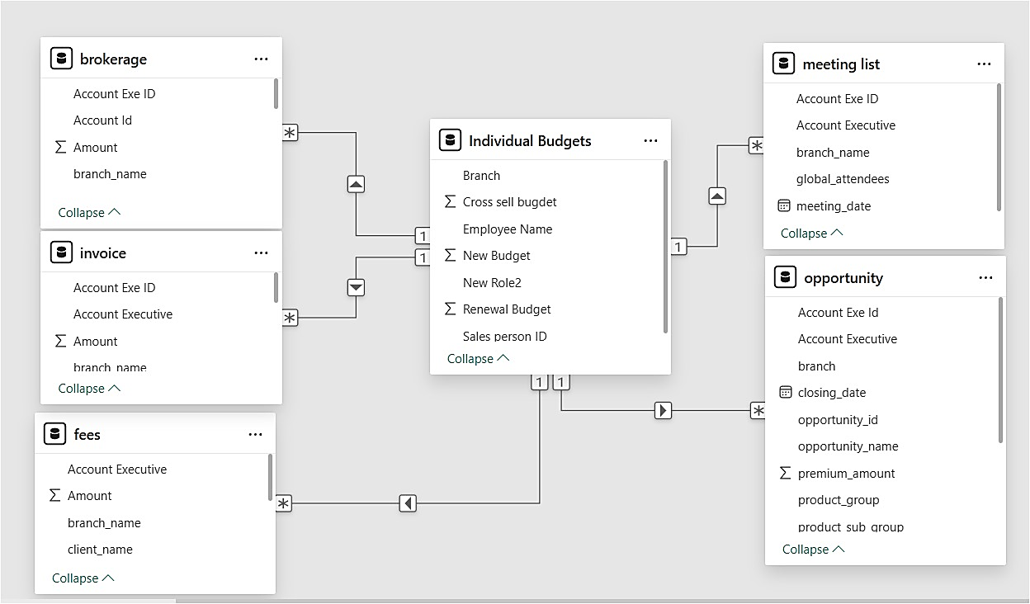
Data Schema

Slide 8

KPI Analysis
No of Invoice by Account Exec
Cross Sell
New
Top Open Opportunity
Target, Achieve, new
KPI
Renewal
No of meeting By Account Exe
Yearly Meeting Count
7/4/2024
7

Slide 9
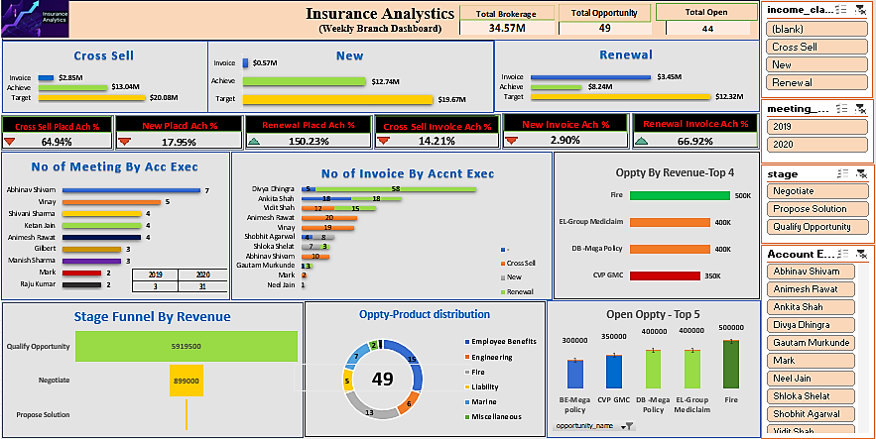
EXCEL
Strength-
Renewal segment excels with 150.23% placement and 66.92% invoice achievement, driving the highest contribution to brokerage.
Strong AE performance and pipeline visibility with 49 open opportunities and high-value deals up to $500K.

Slide 10
EXCEL
INSURANCE ANALYTICS DASHBOARD
Key -
Total Brokerage: ₹34.57M from 49 opportunities (44 still open).
Renewal : Strong performance – 150.23% placed achievement.
Cross Sell & New: Underperforming – only 64.94% & 17.95% placed.
Funnel Blockage: ₹5.9M stuck in early stage ("Quality Opportunity").
Top Opportunities: Fire, CVP GMC, DB-Mega – ₹2M+ value pending.
Top Performers:
Meetings: Abhinav Shivam, Viraj
Invoices: Divya Dhingra, Ankita Shah
Summarize: -
Renewal business is performing well, but Cross Sell and New need immediate attention.
The sales funnel is full at the top but lacks depth toward closure.
Key AEs are excelling; we can leverage their practices across the team. Let’s prioritize conversion and move high-value opportunities toward closure in the coming week.

Slide 11
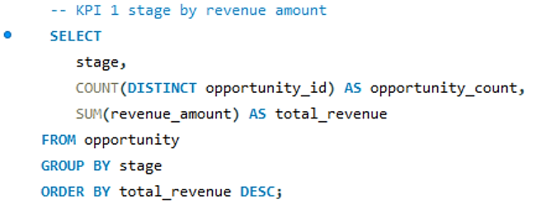
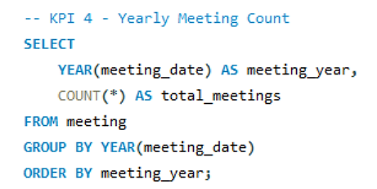
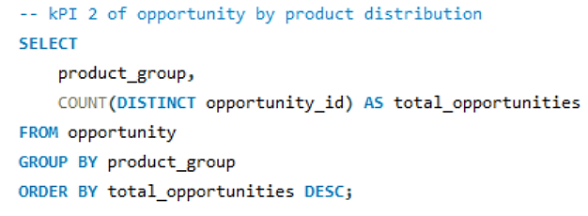
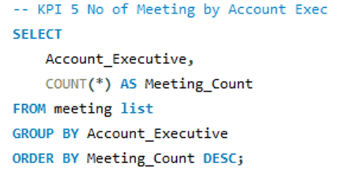
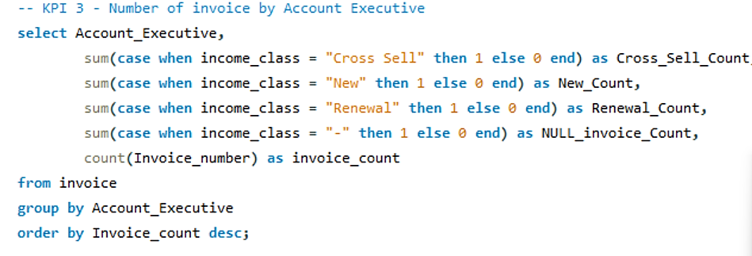
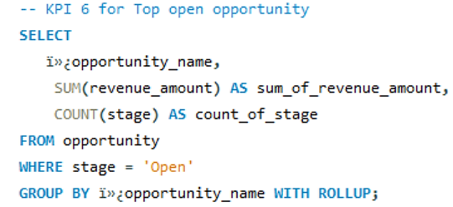
SQL Commands

Slide 12
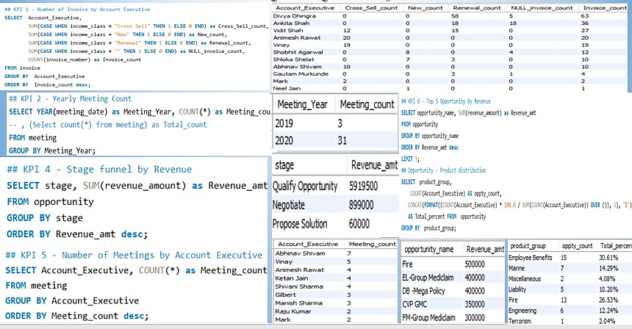
SQL
INSURANCE ANALYTICS DASHBOARD

Slide 13
SQL
Stage-Wise Revenue Analysis
Summed total revenue and counted opportunities across each sales stage.
Product-Wise Opportunity Distribution
Ranked product groups by number of opportunities to identify top-performing segments.
Invoice Distribution by Executive
Segregated invoice counts into Cross Sell, New, and Renewal categories per executive.
Yearly Meeting Trends
Tracked the total number of client meetings conducted each year.
Meetings by Account Executive
Ranked executives based on number of meetings held for performance benchmarking.
Top Open Opportunities
Listed open opportunities by revenue and opportunity count to prioritize sales efforts.
Keys :
SQL is used to transform raw insurance data into decision-ready KPIs.
The queries focus on revenue tracking, opportunity insights, executive performance, and meeting trends.
Outputs are visualized in Power BI/Tableau dashboards to enable interactive analysis.

Slide 14
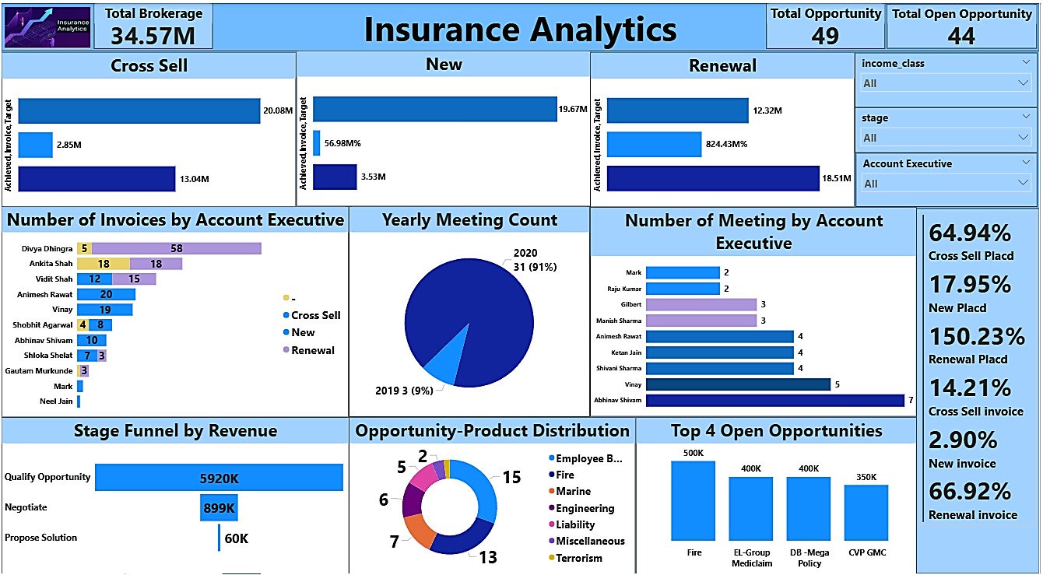
POWER BI
Strength
Renewal segment leads with high invoice achievement (18.51M vs. 12.32M target) and strong AE contributions, especially from Divya Dhingra and Abhinav Shivam.
Engagement and pipeline visibility are strong with 31 meetings in 2020 and 44 open opportunities, including high-value deals up to $500K

Slide 15
POWER BI
INSURANCE ANALYTICS DASHBOARD
Key :
Strong performance in Cross Sell & Renewals
Heavy funnel volume in early stages
Opportunity to improve conversion from qualify to proposal
Top AEs and product lines identified for strategic focus
summarize:
We're seeing great momentum in Cross Sell and Renewals.
However, most revenue is stuck in early funnel stages — indicating a need to strengthen follow-up and conversion strategies.
The dashboard also highlights high-performing executives and high-potential products that we should double down on."

Slide 16
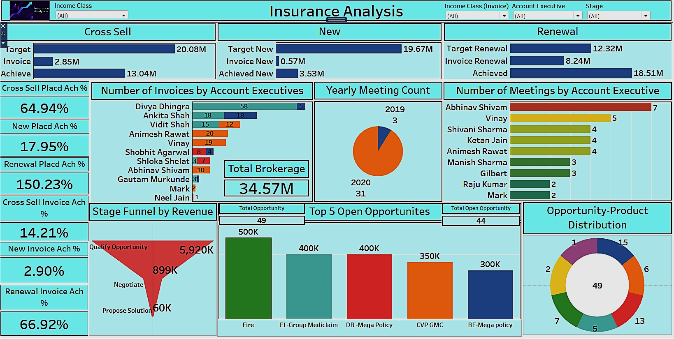
TABLEAU
Strength-
Strong renewal performance with exceptional placement and high-value open opportunities.
Top executives driving results and improved client engagement with increased yearly meetings.

Slide 17
TABLEAU
INSURANCE ANALYTICS DASHBOARD
Key :
Revenue Achievement Performance
Renewal is the strongest performing segment:
Achieved: $8.24M out of $12.32M target → 66.92%
Cross Sell and New Business continue to underperform:
Cross Sell: $2.85M out of $20.08M → 14.21%
New Business: $0.57M out of $19.67M → 2.90%
Focus Area: Immediate attention needed on New and Cross Sell strategies to improve conversion rates.
Summarize :
Renewal business is performing well, with strong achievement rates.
New and Cross Sell segments are underperforming and need strategic focus.
Divya Dhingra and Abhinav Shivam are key contributors on the invoicing and meetings front.
There’s a pipeline bottleneck after the qualification stage that needs immediate attention.
Lastly, top open opportunities are worth nearly $2M and could significantly boost results if closed

Slide 18
Conclusion
New Policies
- Steady growth with a decent profit margin. Need to focus on increasing the growth rate.
Total: 19.674 M
Profit: 0.5698 M
Revenue: 3.5316 M
Profit Margin: 17.95%
Growth Rate: 2.90%
Cross-Sell Policies
- High profitability and significant growth. Continue leveraging cross-selling opportunities.
Total: 20.083 M
Profit: 2.854 M
Revenue: 13.04 M
Profit Margin: 64.94%
Growth Rate: 14.21%
Renewal Policies
- Exceptional performance in renewals with very high profitability and growth. Maintain this strong focus.
Total: 12.32 M
Profit: 8.244 M
Revenue: 18.507 M
Profit Margin: 150.23%
Growth Rate: 66.92%

Slide 19
Recommendations
-Enhance Customer Service
Implement Al-driven chatbots for 24/7 customer support.
Train staff on customer engagement and conflict resolution.
-Expand Product Offerings
Introduce new insurance products tailored to emerging markets.
Bundle products for better value to customers.
-Employee Engagement
Foster a positive work environment to boost employee morale.
Introduce employee recognition programs to retain top talent.
-Increase Sales and Retention
Launch personalized marketing campaigns based on customer data.
Introduce loyalty programs to reward long-term customers.
-Market Analysis and Adaptation
Conduct market research to identify customer needs and preferences.
Adjust strategies based on competitive analysis and market trends.
-Enhance Operational Efficiency
Conduct regular training sessions for employees on new technologies.
Team collaboration activities

Slide 20


